Slide 1
DIGITAL FORENSICS & DEEP LEARNING
Image Forgery Detection
Error Level Analysis (ELA) and Lightweight CNN with 2D FFT & Grad-CAM Explainability
CASIA 2.0 Benchmark Study • Automated Tampering Classification

Slide 2
OBJECTIVE & WORKFLOW
Automated Detection Pipeline
Fake edits fool human eyes; invisible JPEG compression artifacts expose tampering.
01
02
03
04
Input Image
ELA Conversion
CNN Classifier
Verdict & XAI
Suspect JPEG image loaded.
90% re-save error residual.
3-block convolutional feature extraction.
Binary score plus Grad-CAM.
End-to-end automated image forgery detection pipeline combining ELA preprocessing with CNN classification.

Slide 3
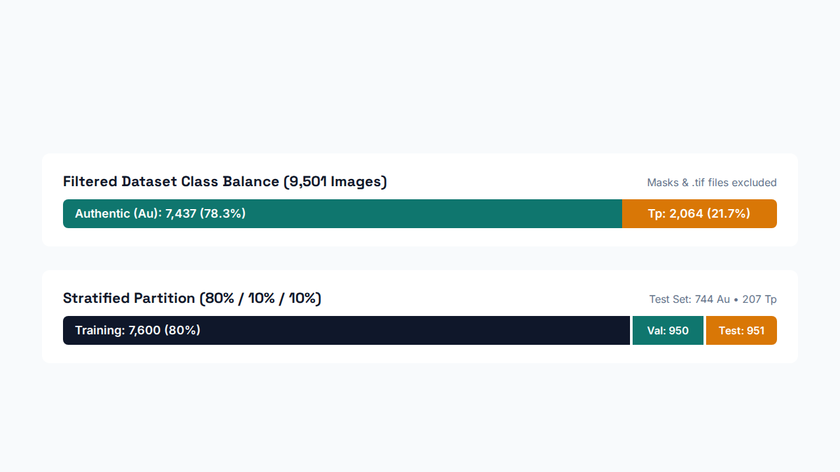
DATA PREPARATION
CASIA 2.0 Dataset Split
Distribution of Authentic and Tampered samples across training, validation, and unseen test splits.

Slide 4
FEATURE ENGINEERING
Error Level Analysis (ELA)
How ELA Works
Authentic vs. Tampered ELA
90% JPEG Re-Save: Recompresses input image at fixed quality.
Authentic Surface: Uniform dark grain across entire frame.
Pixel Residual: Amplifies difference between original and re-saved.
Spliced Region: Distinct bright error residuals at edit boundary.
Model Input: Resized to 128 × 128 × 3 RGB tensors.
Compression Mismatch: Edited patches degrade at different rates.
ELA exposes localized JPEG compression inconsistencies invisible in standard RGB pixel space.

Slide 5

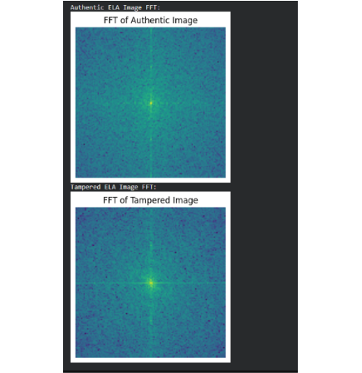
FREQUENCY DOMAIN
2D FFT Frequency Analysis
Authentic ELA Spectrum (Top)
Even noise spread across all frequencies from uniform compression.
Tampered ELA Spectrum (Bottom)
Bright yellow-green center cluster marks disrupted low-frequency patches.
Diagnostic Value
Frequency shifts confirm structural compression anomalies after splicing.
2D FFT spectra of ELA residuals: Tampered ELA concentrates energy at the low-frequency center.

Slide 6
MODEL DESIGN
CNN Architecture & Training
3 Conv Blocks
Classifier Head
Best Checkpoint
32, 64, 128 filters with BatchNorm & MaxPool.
4.28M parameters, Dropout 0.5, Sigmoid output.
Adam (1e-4) reached 95.89% validation accuracy at Epoch 10.
Trained with Binary Cross-Entropy and EarlyStopping (patience 10), halting at Epoch 16 after peaking at Epoch 10.

Slide 7
QUANTITATIVE EVALUATION
Unseen Test Set Results
94.95%
0.99
87.32%
89.86%
Test Accuracy
ROC-AUC Score
Tampered Precision
Tampered Recall
903 / 951 test images classified accurately with 0.89 F1-Score on the tampered minority class.
Exact AUC: 98.62%
Evaluated on 951 held-out test images (744 Authentic, 207 Tampered) using best_model.h5 weights.

Slide 8
ERROR ANALYSIS
Confusion Matrix Breakdown
Actual \ Predicted | Predicted Authentic | Predicted Tampered
Actual Authentic (744) | 717 (TN) | 27 (FP)
Actual Tampered (207) | 21 (FN) | 186 (TP)
Low False Alarms (3.63%)
Only 27 of 744 authentic photos misflagged.
Low Miss Rate (10.14%)
186 of 207 spliced forgeries successfully detected.
Confusion matrix across 951 test samples: 903 true predictions and 48 total misclassifications.

Slide 9
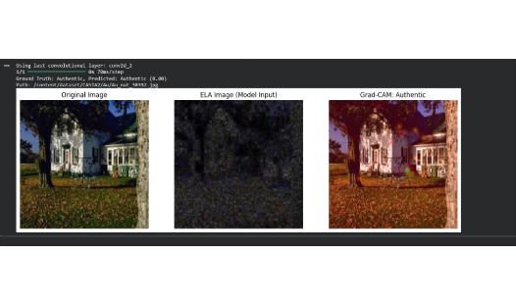
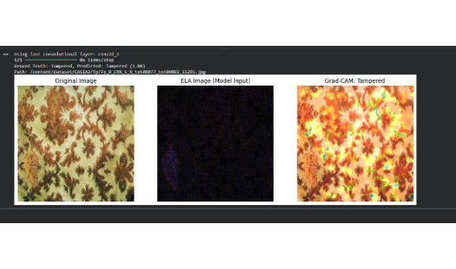
MODEL INTERPRETABILITY (CONV2D_2)
Grad-CAM Explainability
Authentic Sample (Score: 0.00)
Tampered Sample (Score: 1.00)
Diffuse heatmap confirms zero false tampering triggers.
ELA isolates bottom-left leaf; Flatten spreads activation globally.
Grad-CAM on conv2d_2 validates clean authentic predictions (left) and high-confidence forgery detection (right).

Slide 10
CONCLUSION & ROADMAP
Key Takeaways & Future Scope
ELA paired with a lightweight CNN achieves 94.95% accuracy and 0.99 ROC-AUC on CASIA 2.0.
01. Add .tif Forgeries
02. Sharper Grad-CAM
03. Dual-Stream Input
Include 3,000+ CASIA .tif files to balance classes.
Replace Flatten with GlobalAveragePooling2D for tight localization.
Fuse spatial ELA and 2D FFT spectra together.
Thank You • Questions & Discussion

